Slide 1
National IG Profiling Patterns
Framework and Assessment Against Framework

Slide 2
Welcome & Housekeeping
Initially an in-person breakout session - interest in having ability for call in so we’re attempting a hybrid approach
We’ll give a few minutes to let people filter in the room and to check audio
Zoom callers - please rename yourself to also include the country you are representing
Please mute your microphones if you are in a place with background noise
All - please raise your hands when you have questions or comments
Vassil will tracking the order in which people raise hands and calling on people to speak
At the beginning of your comment, please state your name and country for those who may not know each other yet
There will be slides where we will ask you to provide more context on your national guides and placement on the framework

Slide 3
Agenda
Housekeeping (5 minutes)
Providing context for discussions to date (5 minutes)
Outline Emerging Framework & Key Considerations (15 minutes)
Validating your Nation’s Pattern (~5 minutes per country)
Discuss if there are patterns we think are promising for scalability/if any can be ruled out for harmonization (~20 min)

Slide 4
Impromptu Meetup -> Emerging Collaborative
Two Impromptu Meet-Ups at January 2023 Working Group Meeting;
22 voices (20 on site/2 virtually) –
Australia, Belgium, Canada, Denmark, Estonia, Japan, Netherlands, New Zealand, Norway, Switzerland, Portugal, UK, USA
Livestream notes of first session: https://chat.fhir.org/#narrow/stream/261969-IPA/topic/National.20IG.20Meetup.20.40.20Mon.20Q5.20in.20Assissi
Theme 1: We are mixed in our maturity - some of us have 20+ National IGuides others are beginning the process
Theme 2: We have ecosystem differences that lead to operational differences – some funded with established levers to enforce use and of National Guides or to enforce publishing through a National Registry, others are non-funded or grassroots
Question remains whether there is a true minimum that we share (e.g., organic international core) or whether the approach is more likely a superset
Theme 3: Differences in how we’re using and classifying terms –
Core distinction is based on use of MS vs inclusion of CapabilityStatements vs ability to enforce through legislation/governance
Theme 4: Change & isolation represents a risk for many of us – there is a desire to be involved and influence expectations that will impact our guides

Slide 5
Key Takeaways from January 2023 WGM
We want to document how our guides work in our respective countries and assess differences
Started a Confluence Page for National IG Authors to categorize their guides: https://confluence.hl7.org/display/IC/National+IG+Implementations
We’ve advocated the HL7 International Council to allow us to complete this work before formally landing on a definition for Base & Core
Once we have an idea of patterns expressed – we want to discuss an approach to harmonization at the next WGM (May) & DevDays (June)

Slide 6
Steps
Nations post details about their guides on National IG Confluence
Framework provided by NL and NO is refined to include any layers expressed by current National IGuides
Document the National IGuides against the Framework and Validate placement with IGuide authors
Pre-work over chat.fhir.org/Confluence page for folks who can’t attend WGM session
Please add your national guide as a slide if you don’t see it represented yet
HL7 May WGM Sunday Breakout Session
HL7 May WGM Sunday Session to validate patterns and discuss what patterns make sense to harmonize around (both nationally and internationally)
DevDays Roundtable - to discuss how our tooling and governance ecosystem can better support the ability to layer and demonstrate conformance to both national (e.g., US Core, Basisprofil DE, PS-CA) and universal realm (e.g., IPA, IPS, Provider Directory) guides
We’re Here

Slide 7
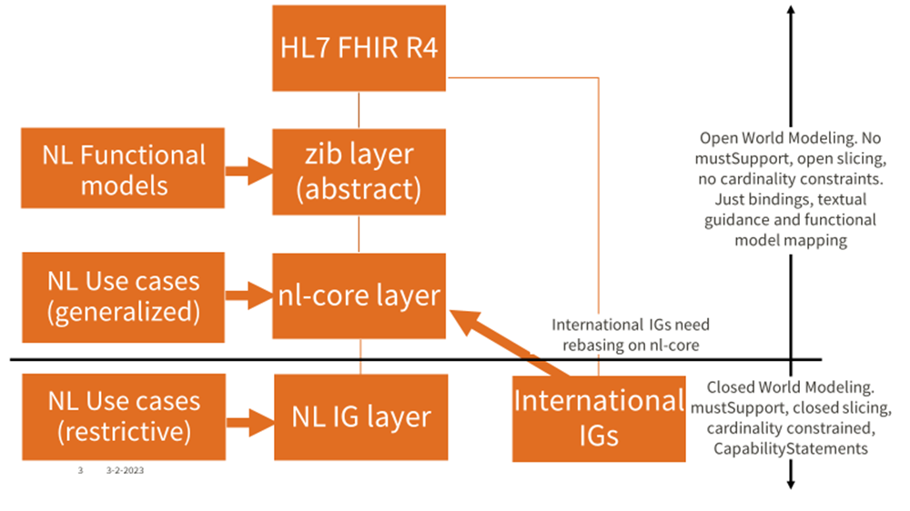
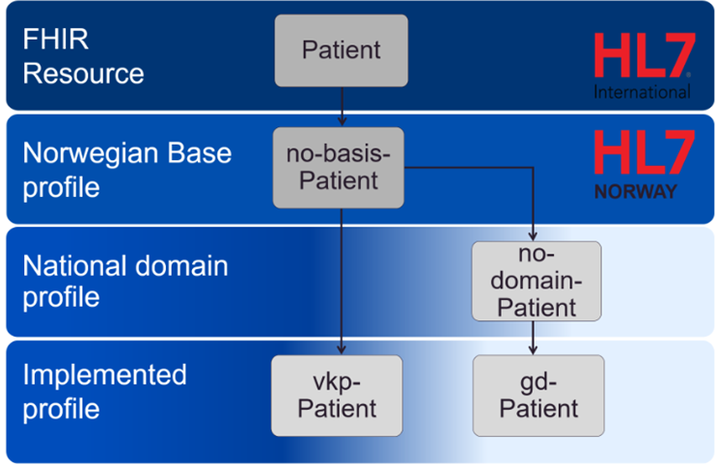
Emerging Framework
Frameworks initially shared with HL7 International Council. These have been combined into a proposed framework and expanded based on the patterns we’ve seen in the other national guides
Because our naming conventions are different, this framework gives us a foundation for describing what patterns are in use currently and what patterns we think scale well for relationships between national guides as well as relationships with international guides
Netherlands Relationships Between Profiles
Norway Relationships Between Profiles

Slide 8
Emerging Framework
(using concepts from Netherland and Norway)
Base FHIR Resource
Open World Modeling
Items in orange were added based on what was observed in the analysis of other national profiles
No mustSupport, No cardinality constraints.
Bindings, open slicing, textual guidance and functional model mapping
National Abstract Profile (Use Case Agnostic)
National Use Case Profile (Generalized)
Best practice guidance (terminology, approach, recommendations for re-use by other IGuides)
mustSupport, cardinality constraints
National Use Case Profile (Restrictive)
Use case related guidance,
closed slicing
Where do international Profiles fit in this framework….and this hierarchy?
Regional Use Case Profile (Restrictive) - If Applicable
Site identifiers/extensions, guidance on integrating with regional assets
International Use Case Profile (Restrictive)
CapabilityStatements
Implementation Profile (Most Restrictive)
How does the place in the hierarchy impact how National FHIR Authors “use” international profiles?
Closed World Modeling
Notes:
Summarized from: https://github.com/HL7Norway/best-practice/blob/master/docs/no-profileringshierarki.md and https://www.youtube.com/watch?v=8pv-Zztibyg
National Abstract Profiles: describe the minimum adaptations/national context necessary to use an international resource in the nation. Examples include provision of identifiers, extensions, national codes, and national information needs (e.g., middle name for a patient). These profiles are open and general and intended to be the basis for all applications, regardless of use-case, of the given international resource in the Norwegian health sector.
National Domain/Use Case - adapts international resources for a specific use case. Represents information structures that can be reused across implementations for the defined use case. Can be use directly or profiled further for use in specific implementations.
Separated generalized from restrictive to account for variability in in how nations expressed use case constraints and architectural expectations/integrations with controlled national assets. NL weigh in on how they’ve understood the separation.
Regional Use Case Profile: Added as well to describe layer we were seeing with some nations having regions that hosted profiles with specific region or site identifiers. These could be Generalized or restrictive. Restrictive tended to describe integrations with regionally assets (e.g., clinical data stores, provider directories)
Implementation profile: describes what is implemented in an application service.

Slide 9
Key Considerations
Base FHIR Resource
Open World Modeling
Slides reflect current state. Some profiles are in development (e.g., derivation pattern may not be decided or applied yet)
National Abstract Profile (Use Case Agnostic)
No mustSupport, No cardinality constraints.
Bindings, open slicing, textual guidance and functional model mapping
Naming convention applied inconsistently – political and program context of how and why a Base or Core is created may influence how a National Guide identifies.
National Use Case Profile (Generalized)
Best practice guidance (terminology, approach, recommendations for re-use by other IGuides)
Jurisdictional/Regional guide layer may also exist for some countries – needs to be examined
National Use Case Profile (Restrictive)
mustSupport, cardinality constraints
Distributed governance / differences of ownership of guides/programs can also contribute to differences in choice patterning and will impact approach to harmonization
Sse case related guidance,
closed slicing
Regional Use Case Profile - If Applicable
CapabilityStatements
Our lack of natural harmonization may reflect that our current tools and processes don’t yet support a single option that scales well domestically and internationally across a variety of national contexts
Implementation Profile (Most Restrictive)
Closed World Modeling

Slide 10
Validating Your Nation’s Pattern
Please provide the following context for your national guides and confirm correct placement on the framework
Is the placement correct?
How intentional in the patterning you’ve pursued?
Has governance/program ownership impacted your decision on promoting derivation in your country?
Have you considered how international use case profiles (e.g., IPS, IPA, Provider Directory) might fit into your pattern?

Slide 11
Australia Example
(Needs to be Validated)
Resource
PractitionerRole
National Abstract Profile (Use Case Agnostic)
AU Base PractitionerRole
Publishes Base and Core (and some national use case guides) through HL7 Australia
Additional national profiles that involve interactions with national assets are published through Australian Digital Health Agency
AU Core intended to be directly implementable guide that defines implementer obligations including search - just starting and involves FHIR Community Process and National Core Data for Interoperability
National Use Case Profile (Generalized)
AU Core PractitionerRole
National Use Case Profile (Restrictive)
AU PD PractitionerRole
ADHA Core PractitionerRole
ADHA Authoring PractitionerRole
Implementation Profile (Most Restrictive)
International Use Case Profile (Restrictive)
IPA Practitioner

Slide 12
Belgium Example
Resource
Patient
Belgian standardization process considers two types of publishing: legally sanctioned (eHealth Platform), voluntary basis (HL7 Belgium); but they share work groups and process, only the status of the outcome is different.
National Use Cases that are regulated by law shall at least implement the IGs that are published by eHealth Platform. Other initiatives are free to adhere on a voluntary basis.
We consistently use logical data models as abstraction (like the ZIBs, or WHO L2).
Use-case agnostic profiles: we didn't start by profiling and modeling a “base” - we build up the profiles (including “core”) as needed. New use cases can reuse existing profiles, and profiles are expected to be updated to accommodate for reuse.
National Abstract Profile (Use Case Agnostic)
National Use Case Profile (Generalized)
National Use Case Profile (Restrictive)
BE Federal Core Patient
BE Lab Observation
Implementation Profile (Most Restrictive)
International Use Case Profile (Restrictive)
IPA Patient

Slide 13
Canada Example
Resource
Patient
Publishes CA Baseline through grassroots FHIR implementers group with assistance from HL7 Canada
CA Baseline includes a handful of must supports, conditional cardinality rules, and broad terminology recommendations (likely isn’t fully use case agnostic)
Some early implementation profiles have started deriving from CA Baseline, but most informally align/point reference targets to CA Baseline profiles (e.g., Patient)
National Program for developing a Use Case Driven Profiles (Core+) and potentially generalized Core in the future is starting but profiles are not developed yet
National Abstract Profile (Use Case Agnostic)
CA Baseline Patient
National Use Case Profile (Generalized)
National Use Case Profile (Restrictive)
PS-CA Patient
Regional Use Case Profile (Restrictive)
PS-AB Patient
Implementation Profile (Most Restrictive)
International Use Case Profile (Restrictive)
IPS Patient

Slide 14
Denmark Example
(Needs to be Validated)
Resource
Patient
National Abstract Profile (Use Case Agnostic)
DK Core Patient
Publishes Core through HL7 Denmark
Recent updates to derive some of its base profiles off of IPA
National Use Case Profile (Generalized)
National Use Case Profile (Restrictive)
Implementation Profile (Most Restrictive)
International Use Case Profile (Restrictive)
IPA Patient

Slide 15
Finland Example
Resource
Patient
Started with use case dependent implementation guides. Some published by HL7 Finland, some by government agencies, some by industry.
Base profiles now being published through HL7 Finland.
Attempt to be use case agnostic. Some ideas presented for some use cases.
Attempting to derive its base profiles off of IPA wherever possible – though there are profiles in the Base not covered in IPA yet. Still, see IPA as the international profile between the Resource and the National Abstract Profile.
Placement on Framework may vary by Profile
National Abstract Profile (Use Case Agnostic)
FI Base Patient
National Use Case Profile (Generalized)
National Use Case Profile (Restrictive)
Implementation Profile (Most Restrictive)
Finnish PHR Patient
International Use Case Profile (Restrictive)
IPA Patient

Slide 16
Estonia Example
Resource
Patient
Base currently hosted by Health and Welfare Information System Center (TEHIK).
HL7 Affiliate application submitted.
National Health Information System (NHIS) profiles mandatory for all HCP systems for data exchange with central NHIS. Published by TEHIK.
Implementing a national information model layer to improve interoperability outside the strictly regulated national services.
National Abstract Profile (Use Case Agnostic)
EE Base Patient
National Use Case Profile (Generalized)
National Use Case Profile (Restrictive)
NHIS Patient
Implementation Profile (Most Restrictive)
[vendor] Patient
International Use Case Profile (Restrictive)
IPA Patient

Slide 17
Italy Example
(Needs to be Validated)
Resource
Patient
National Abstract Profile (Use Case Agnostic)
Balloted Base through HL7 Italy, however there was not enough feedback to publish
Some use case guides in development but require more policy commitment
Intent is to build hierarchy of profiling, though there may be cases to consider that may not use derivation
Some guides published outside the affiliate to describe interactions with regional assets
IT Base Patient
National Use Case Profile (Generalized)
National Use Case Profile (Restrictive)
Regional Use Case Profile (Restrictive)
Lombardy Region Patient
Implementation Profile (Most Restrictive)
International Use Case Profile (Restrictive)
IPA Patient

Slide 18
Netherlands Example
(Needs to be Validated)
Resource
Patient
National Abstract Profile (Use Case Agnostic)
NL-core Patient
zib Patient
National Use Case Profile (Generalized)
Publishes Zib, Core, and Implementation profiles through Nictiz
Additional implementation profiles published by other organizations (e.g., VZVZ) derive from NL-core
National Use Case Profile (Restrictive)
Implementation Profile (Most Restrictive)
International Use Case Profile (Restrictive)
bc-Woman
IPA Patient

Slide 19
New Zealand Example
(Validated)
Resource
Patient
National Abstract Profile (Use Case Agnostic)
Publishes Base (and some national use case IGs) through HL7 New Zealand. All other national IGs published by Health NZ (has subsumed regions).
New Zealand IPS Simplifier project “re-publishes” IPS Profiles to ensure use.
Some national and vendor implementation profiles inherit directly from the IPS profiles.
NZ Base Patient
National Use Case Profile (Restrictive)
NHI Patient
National Use Case Profile (Restrictive)
IPS Patient
Implementation Profile (Most Restrictive)
NZ Medic Alert Patient
International Use Case Profile (Restrictive)
IPS Patient

Slide 20
Norway Example
(Needs to be Validated)
Resource
Patient
National Abstract Profile (Use Case Agnostic)
Publishes Basis and Domain profiles through HL7 Norway
Implementation profiles that derive from the Basis and Domain profiles may be hosted by HL7 Norway or elsewhere in community
NO-basis-Patient
National Use Case Profile (Generalized)
NO-domain- Patient
National Use Case Profile (Restrictive)
Implementation Profile (Most Restrictive)
International Use Case Profile (Restrictive)
vkp-Patient
gd-Patient
IPA Patient

Slide 21
Switzerland Example
Resource
Patient
National Abstract Profile (Use Case Agnostic)
CH Core Patient
Publishes CH Core and derived Implementation Guides (CH EMED, VACD) through HL7 Switzerland
Multiple organizations publishing FHIR assets and use case profiles (e.g., Cancer Registration profiles independent of HL7 Switzerland)
Derivation from IPA, conformance to IPS planned for a future revision.
National Use Case Profile (Generalized)
National Use Case Profile (Restrictive)
CH Core Patient - EPR
Implementation Profile (Most Restrictive)
CH EPR mHealth
International Use Case Profile (Restrictive)
IPA Patient

Slide 22
United Kingdom Example
(Needs to be Validated)
Resource
Patient
National Abstract Profile (Use Case Agnostic)
UK Core Patient
Publishes Core Profiles through HL7 UK
Some regional and implementation profiles published by NHS – typically derive from the UK Core Profiles
UK Core Patient Access guide includes note on close related nature to IPA
National Use Case Profile (Generalized)
Regional Use Case Profile (Generalized)
NHS Wales Patient
National Use Case Profile (Restrictive)
UK Core Patient Access Patient
Implementation Profile (Most Restrictive)
International Use Case Profile (Restrictive)
IPA Patient

Slide 23
US Example
(Needs to be Validated)
Resource
Patient
National Abstract Profile (Use Case Agnostic)
Publishes Core and other US guides through US Realm
Requires profiles with US jurisdiction claims to derive from US Core profiles or participate in Variance Request Process
Does not have “Base” layer but have considered this previously
National Use Case Profile (Generalized)
US Core Patient
National Use Case Profile (Restrictive)
QI Core Patient
Implementation Profile (Most Restrictive)
International Use Case Profile (Restrictive)
IPA Patient

Slide 24
Germany Example
(Needs to be Validated)
Resource
Patient
National Abstract Profile (Use Case Agnostic)
IdentifierKvid10
Publishes “Basisprofile DE” through HL7 DE
Some regional and implementation profiles published by gematik and KBV – typically derive from the Basisprofile DE
Main focus: Profiles on Identifier and datatypes. Minimal national abstract profiles available for a selected number of resource types.
National Use Case Profile (Generalized)
coverage-de-gkv
Regional Use Case Profile (Generalized)
National Use Case Profile (Restrictive)
KBV / gematik profiles
Implementation Profile (Most Restrictive)

Slide 25
Patterns Identified So Far
National Guides:
National Abstract Profile Inherited by National Use Case (Restrictive) Profile
Switzerland, UK, Australia, Canada. New Zealand
National Abstract Profile Inherited by Regional Abstract Profile
UK
National Abstract Profile Inherited by National Use Case (Generalized) Profile
Australia, Germany
National Use Case (Generalized) Profile inherited by National Use Case (Restrictive) Profile
Germany, US
National Use Case Generalized Profile provides reference targets for National Use Case (Restrictive) Profile
Belgium, Estonia
International Guides:
International Use Case Profile Inherited by National Use Case Profile (Generalized)
Finland
International Use Case Profile Inherited by National Abstract Profile
Denmark
National Use Case Guides pointing directly to International Use Case Profiles
New Zealand
National Use Case (Restrictive) Profiles that do not technically relate back to International Use Case Profiles
US, UK Core Patient Access* (guide narrative indicating close relation to IPA)

Slide 26
Outstanding Questions
Is there a single national pattern that makes sense to harmonize around?
How do the potential patterns impact our ability to integrate the international use case layer?
What are your biggest blockers that would need to be resolved before you would consider changing your pattern (i.e., if a pattern was selected for harmonization)?
Big Question: How can we make it possible for a vendor to meet both International Use Case Profiles and their National Profiles that are more abstracted without jeopardizing the scope of either?
How do we ensure that the constraints that are introduced or are relaxed due to this relationship are appropriate for the given use case (particularly when national use case scopes differ from the use case scope in the UV profile?)
Is there a world where our national use case projects could point/combine the international conformance artifacts with our national core conformance artifacts without having to create new artifacts for vendors to demonstrate against?

Slide 27
Pattern to Consider
Not expressed currently -
potentially due to tooling constraints
Resource
Patient
National Use Case Specification would point to the conformance artifact from their national base/core and the conformance artifact from the international use case guide. Without re-profiling or creating a new profile.
Would reduce proliferation of profiles, prevent misalignment of how use cases are addressed, and make it easier/faster for vendors to demonstrate they meet the requirements in country (e.g., identifiers, extensions) and the use case requirements established internationally
Would require confidence that the international guide could respond quickly to requests for change from national use case implementation feedback. Likely would require some tooling improvements
National Abstract Profile (Use Case Agnostic)
National Base Patient
National Use Case Profile (Generalized)
National Use Case Specification
Guide
Implementation Profile (Most Restrictive)
International Use Case Profile (Restrictive)
IPA Patient

